Slide 1
Human Trafficking: DEMAND is the Problem
A DEMAND problem

Slide 2
Please download and watch the four-minute video, courtesy of Not for Sale. You may also wish to watch: Shared Hope Demand Video:
http://www.sharedhope.org/Media/VideoResources.aspx

Slide 3
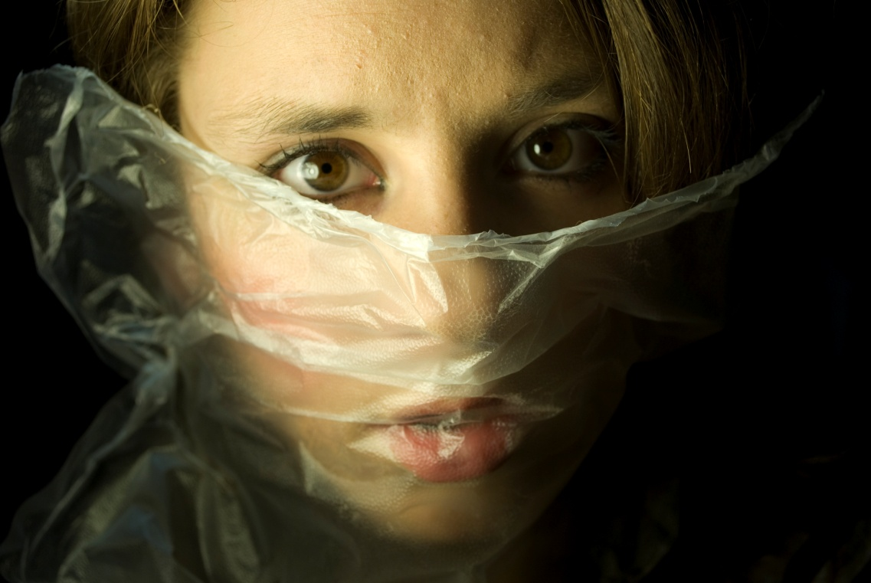

Slide 4
Recruitment, harboring, transportation or obtaining a person for labor or services, by use of force, fraud or coercion for the purpose of slavery, debt bondage or involuntary servitude.
Commercial sex induced by force, fraud or coercion or
in which the person induced is 18 years*
of age or younger.
*16 years of age in the state of Indiana (1)
Senate Enrolled Act 4, 117th G.A., 2nd Reg. Sess. (2012), available at http://www.in.gov/legislative/bills/2012/SE/SE0004.1.html.

Slide 5
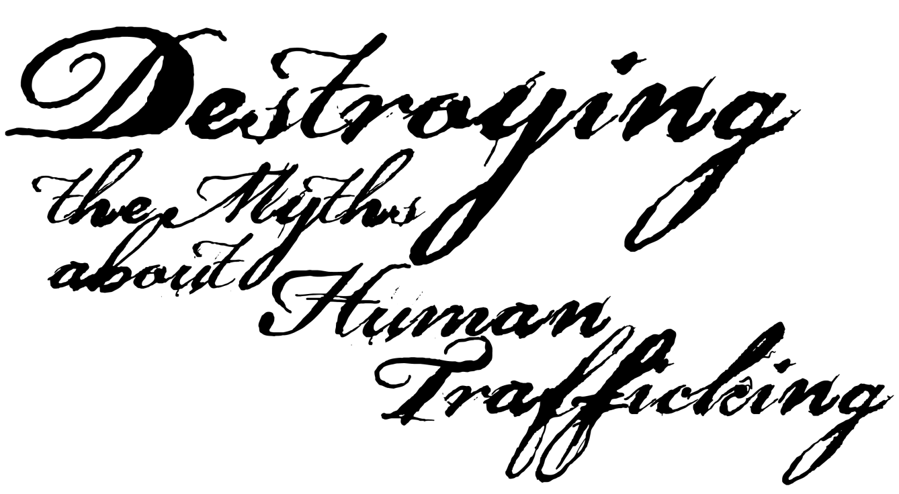
Do you know the FACTS on human trafficking…
Or just the Myths?

Slide 6
Trendy: not a real problem
SECOND LARGEST and FASTEST growing CRIME worldwide, just behind the drug trade (1)
$32 billion dollars is generated annually (2)
Administration for Children & Families, U.S. Dept. of Health & Human Services, http://www.acf.hhs.gov/trafficking/about/index.html (last visited Jan. 13, 2012).
International Labor Organization (ILO), A global alliance against forced labor (2005) at p.55, available at http://www.ilo.org/wcmsp5/groups/public/@ed_norm/@declaration/documents/publication/wcms_081882.pdf.

Slide 7
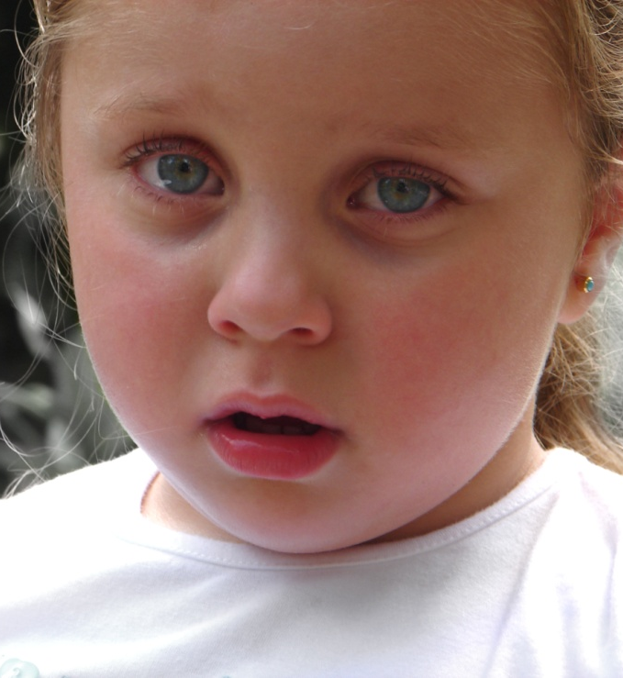
In other
countries,
not U.S.
100,000 to 293,000 U.S. children are in danger of exploitation. (1)
12 to 14 years old is the average age at which girls become victims of prostitution. (2)
83% of minor sex trafficking victims are U.S. citizens. (3)
Testimony of Ernie Allen (July, 2010), National Center for Missing & Exploited Children, available at www.missingkids.com/missingkids/servlet/NewsEventServlet?LanguageCountry=en_US&PageId=4312.
Child Prostitution, U.S. Dept. of Justice, Child Exploitation and Obscenity Section (CEOS), http://www.justice.gov/criminal/ceos/prostitution.html (last visited Jan. 13, 2012).
Human Trafficking/Trafficking In Persons, Dept. of Justice, Bureau of Justice Statistics, http://bjs.ojp.usdoj.gov/index.cfm?ty=tp&tid=40 (last visited 1/14/2012).

Slide 8
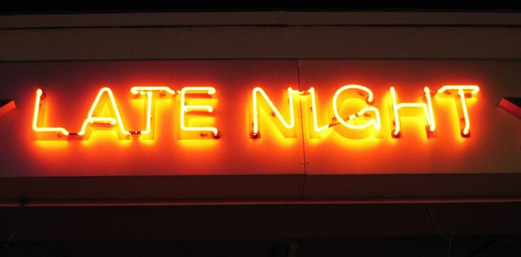
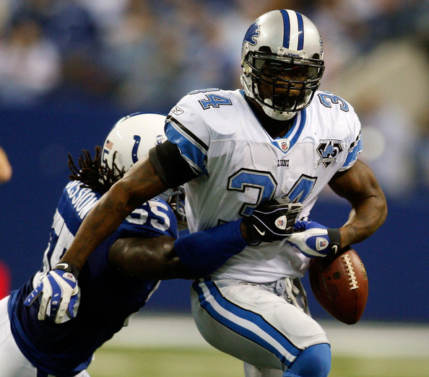
In other countries,
not U.S.
Commercial sexual exploitation is linked to escort and massage services, private dancing, drinking and photographic clubs, major sporting and recreational events, major cultural events, conventions, and tourist destinations. (1)
Child Prostitution, U.S. Dept. of Justice, CEOS, http://www.justice.gov/criminal/ceos/prostitution.html (last visited Jan. 13, 2012).

Slide 9
The following map indicates the demand from the U.S. and other wealthy countries.

Slide 10
UN Highlights Human Trafficking, Origin & Destination Countries, BBC News available at http://news.bbc.co.uk/2/hi/in_depth/6497799.stm.
Notes:
Red and peach colored areas represent countries that supply the highest numbers of trafficking victims.
Blue colored areas represent countries that receive the highest numbers of trafficking victims.

Slide 11
Only in big cities
Of the 2,515 Department of Justice task force initiated trafficking investigations: (1)
50 cases were opened by Indiana law enforcement and 41 were served by nonprofits. (2)
Note: These statistics are very low due to the difficulty in identifying/finding victims; human trafficking victims are easy for traffickers to hide.
Characteristics of Suspected Human Trafficking Incidents, 2008-2010 at 1 (2011), U.S. Dept. of Justice, available at http://bjs.ojp.usdoj.gov/content/pub/pdf/cshti0819.pd; see also Human Trafficking/Trafficking in Persons, http://bjs.ojp.usdoj.gov/index.cfm?ty=tp&tid=40 (last visited Jan. 25, 2012).
IPATH Taskforce Grant Reports, Indiana Protection for Abused & Trafficked Humans.

Slide 12
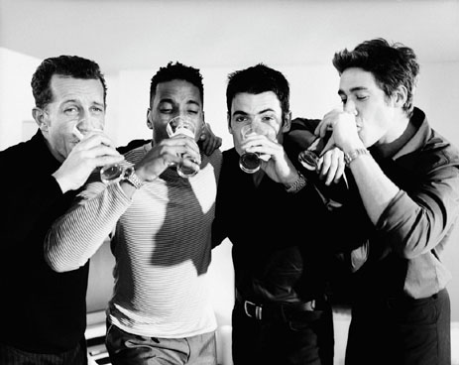
Our culture emphasizes:
Partying
Youth
Power
Money
Sexuality
Consider the message of movies like The Hangover and advertisements that use sexuality to sell clothing, perfume, cars, and more.

Slide 13
Prostitutes & strippers are portrayed in movies, video games & rap songs.
Three 6 Mafia's song "It's Hard Out There for a Pimp" won an Oscar in 2006.
“Pimp” is now slang that means “to improve” or “to customize” (like in MTV’s show “Pimp My Ride”).
Demand for this crime exists because society/WE tolerate it:
MySpace now has an option to “pimp-my-profile.”

Slide 15
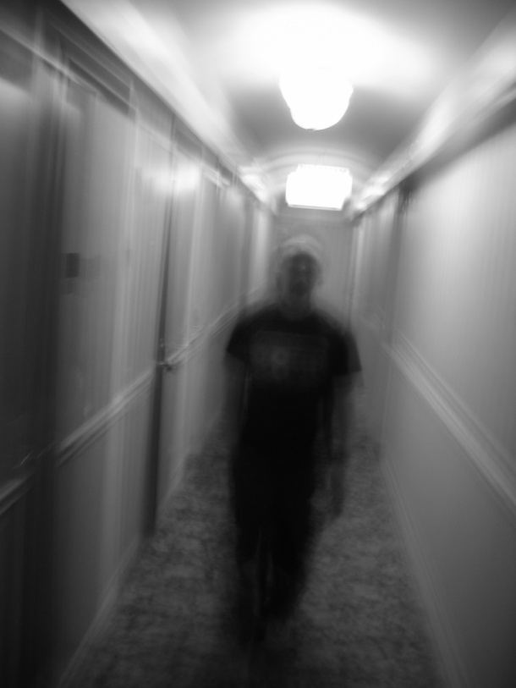
• The trafficker (“pimp”) may be part of a larger organized crime ring, or
may be profiting
independently.
• Most often, he/she is the same race/ethnicity as the victim.
The trafficker might be someone who knew the \ victim and victim’s family.
Will likely be bilingual
Will likely be an older man with younger women who seems to be controlling, correcting, speaking for the victims

Slide 16
Pimps are cool and protect
the girls they “manage.”
• Pimps take all of the money. (1)
• They force the women and children to earn nightly monetary quotas to avoid beatings. (1)
• Pimps even “brand” those under their control with tattoos of their name to demonstrate ownership. (1)
Quote from pimp: “it’s impossible to protect all girls from guys….We eat, drink and sleep thinking of ways to trick young girls into doing what we want.”(2)
Human Trafficking FAQs, How is Pimping a Form of Sex Trafficking?, Polaris Project, http://www.polarisproject.org/human-trafficking/human-trafficking-faqs#How is pimping a form of sex trafficking? (last visited Jan. 14, 2012).
Jody Raphael & Brenda Myers-Powell, From Victims to Victimizer: Interviews With 25 Ex-Pimps in Chicago (2010) at 5, Schiller DuCanto & Fleck Family Law Center of DePaul University College of Law, available at http://newsroom.depaul.edu/PDF/FAMILY_LAW_CENTER_REPORT-final.pdf.

Slide 17
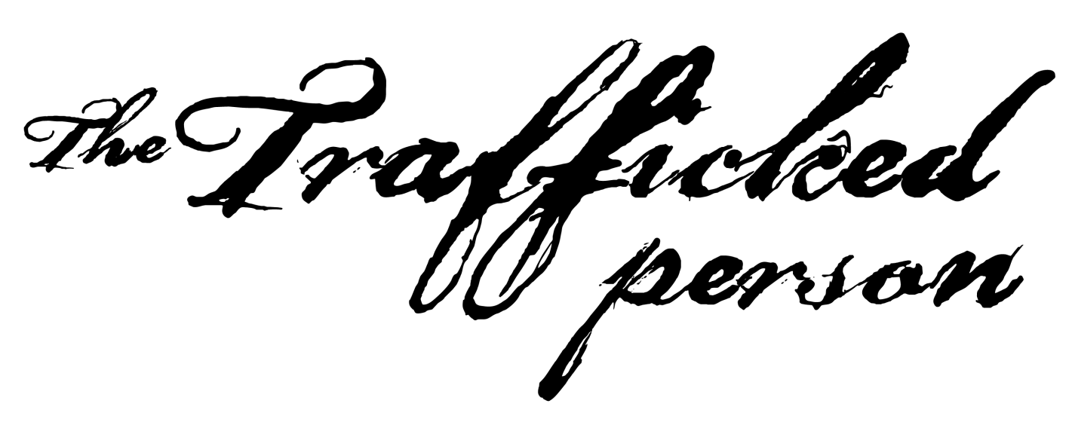
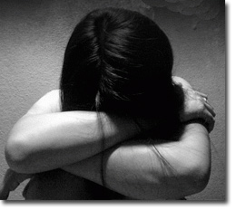

Slide 18
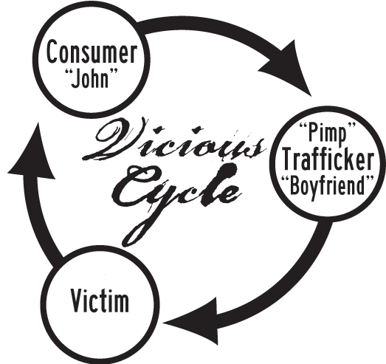
They are
in control.
It’s a complex and violent crime.

Slide 19
MYTH: “ Prostitution is a victimless crime. It’s between two consenting adults, so it’s ok. After all, I’m paying for her/ his service so it’s “win-win” for both of us.”
FACT: The average age that girls first become victims of prostitution is 12-14 years old. (1)
• Human Trafficking reaches every culture and demographic.
• HT Victims are
VULNERABLE
Some risk factors include:
Poverty
Immigration status
Unemployment
Desperation
Family backgrounds strife with violence, abuse, conflict
Homelessness
A need to be loved
Child Prostitution, U.S. Dept. of Justice, CEOS, http://www.justice.gov/criminal/ceos/prostitution.html (last visited Jan. 13, 2012); see also U.S. Children are Victims of Sex Trafficking (April 2008), humantrafficking.org, http://www.humantrafficking.org/updates/801.

Slide 20
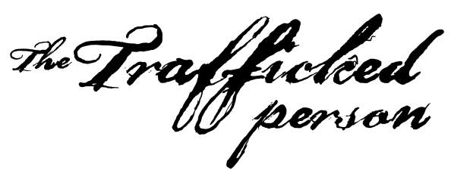
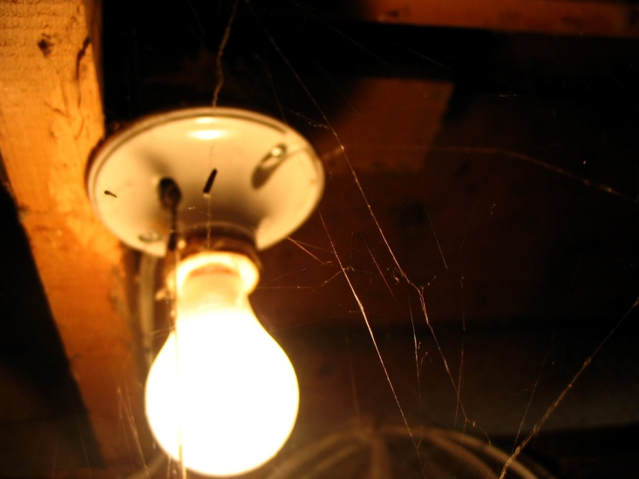
Likely has been lied to about the work they will be doing in the U.S.
Is not allowed to have any meaningful social network.
Is extremely embarrassed.
Will likely not see themselves as a victim.
May be holding out hope that if she or he proves their worth, things will get better.

Slide 21
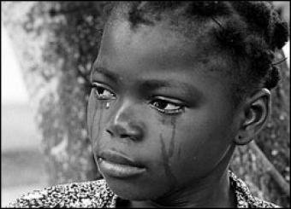
While involved in prostitution:
82% had been physically assaulted. (1)
83% had been threatened with a weapon. (1)
68% had been raped while working as prostitutes. (1)
84% reported current or past homelessness. (1)
Melissa Farley & Howard Barkan, Prostitution, Violence Against Women, and Posttraumatic Stress Disorder, 27 Women & Health 37-49 (1998), available at http://www.prostitutionresearch.com/ProsViolPosttrauStress.html.

Slide 22
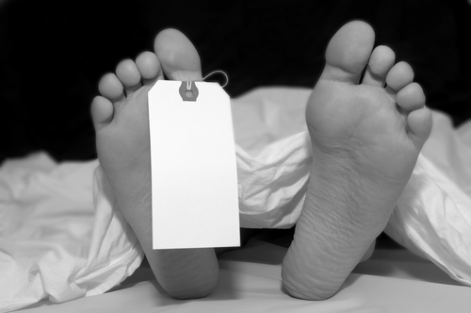
“Prostitution is risky for both men and women; the average age of death is 34. (1)
“…the American Journal of Epidemiology reported that prostitutes suffer a ‘workplace homicide rate’ 51 times higher than that of the next most dangerous occupation, working in a liquor store.”(1)
Leslie Bennetts, The John Next Door, July 18, 2011, The Daily Beast/Newsweek, available at http://www.thedailybeast.com/newsweek/2011/07/17/the-growing-demand-for-prostitution.html.

Slide 23
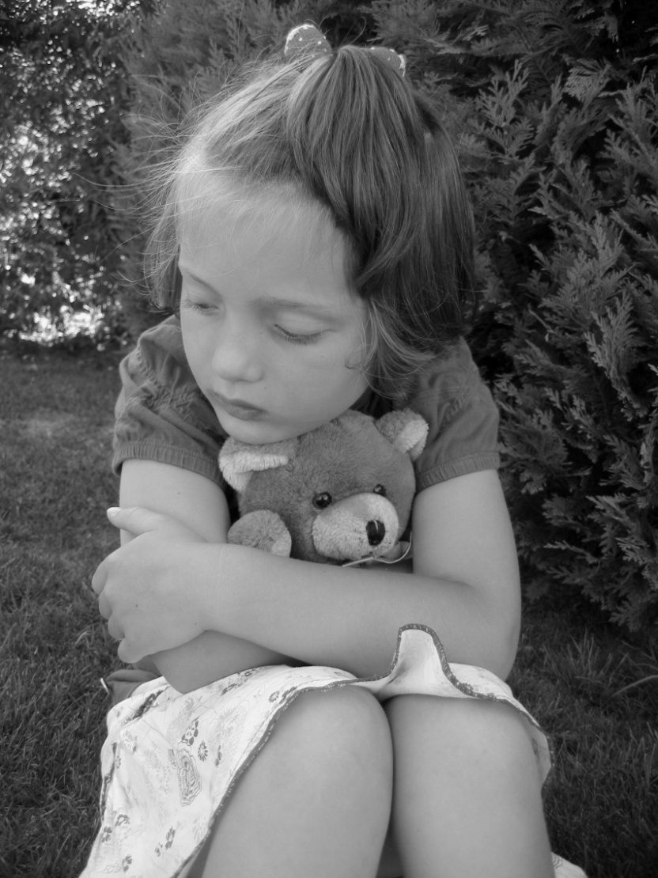
A Vulnerable Life Before Prostitution:
Of boys and girls recruited into the commercial sex industry:
57% had been sexually abused as children. (1)
49% had been physically assaulted. (1)
85% were victims of incest as girls, and 90% had been physically abused. (2)
Melissa Farley & Howard Barkan, Prostitution, Violence Against Women, and Posttraumatic Stress Disorder, 27 Women & Health 37-49 (1998), available at http://www.prostitutionresearch.com/ProsViolPosttrauStress.html.
Hunter, S.K., Prostitution is Cruelty and Abuse to Women and Children, 1 Mich. J. Gender & L. 1-14 (1993).

Slide 24
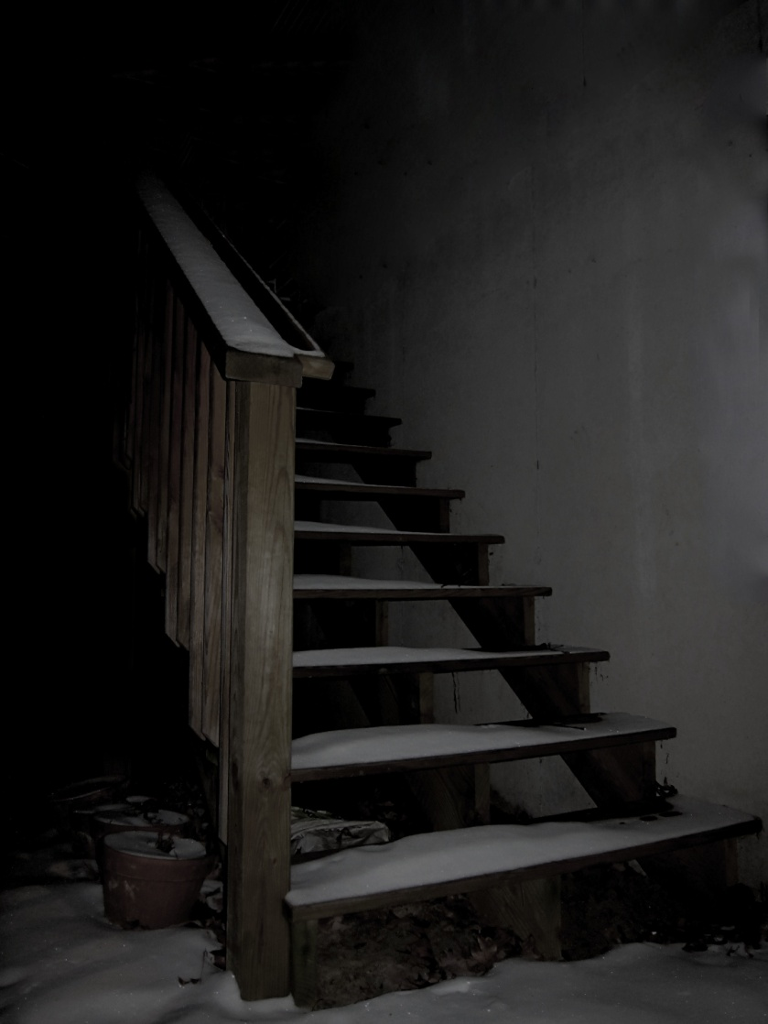
A Vulnerable Life Before Prostitution
61.5% were frequently hit, slapped, pushed, grabbed, or had objects thrown at them by a member of their household. (1)
40% of the above were kicked, hit, beaten, raped, or threatened and/or attacked with a weapon by a member of their household. (1)
Jody Raphael & Deborah L. Shapiro, Sisters Speak Out: The Lives and Needs of Prostituted Women in Chicago, Center for Impact Research (2002) at p.15, available at http://www.impactresearch.org/documents/sistersspeakout.pdf.

Slide 25
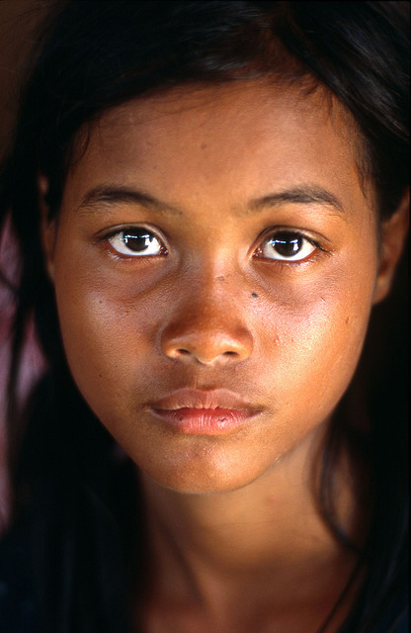
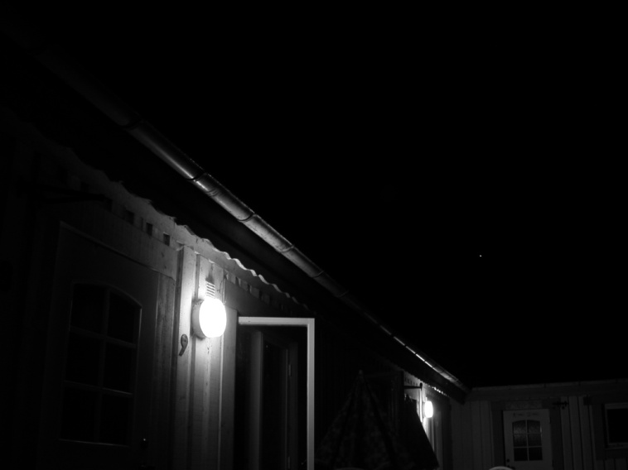
Why don’t they escape?
They are in danger if they try to leave.
The traffickers have a strong psychological and physiological hold on them.
They fear for the safety of their families.
They may fear the legal system.
They are afraid of being deported.
They may not be able to support themselves on their own and have no place to go.
Thus, it is our responsibility to protect and assist people being exploited.

Slide 26
“The girls and boys who prostitute do it because they like it. It’s easy money for them, and no one is forcing them to do it.
It’s just business.”

Slide 27
FACTS:
Victims are lured by false promises of love and support. (1)
• Sometimes they are even kidnapped or abducted. (1)
Utilizing a conservative estimate, a victim would be raped by 6,000 “Johns” during the course of her victimization* through prostitution. (2)
*based on a formula of 5 “Johns” per night, 5 nights per week, for 5 years. (2)
They may be required to perform sex acts with up to 15 different “Johns” per night.
Comparison Chart of Primary Sex Trafficking Networks in the U.S., Polaris Project (2011), available at https://na4.salesforce.com/sfc/play/index.jsp?d=6FuMhnn2HQpD2dARadzU1Ow7p6I%3D&viewId=05H60000000JrOi&v=06860000000HdKZ&oid=00D300000006E4S.
Linda A. Smith, Samantha Healy Vardaman, Melissa A. Snow, Shared hope Intl, The National Report on Domestic Minor Sex Trafficking (2009), http://www.sharedhope.org/Portals/0/Documents/SHI_National_Report_on_DMST_2009.pdf.

Slide 28
Most of the research available focuses on prostitution, rather than strictly on human trafficking.
Remember: anyone who is under 18 or is forced into prostitution is a victim of sex trafficking.

Slide 29
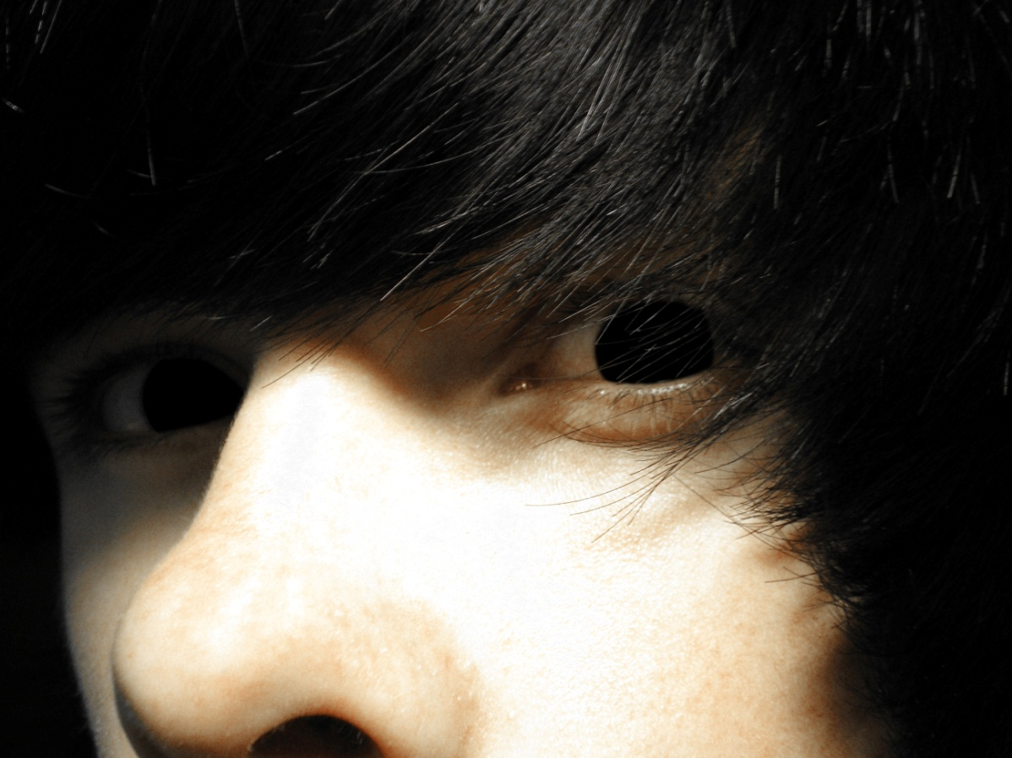
“The John”

Slide 30
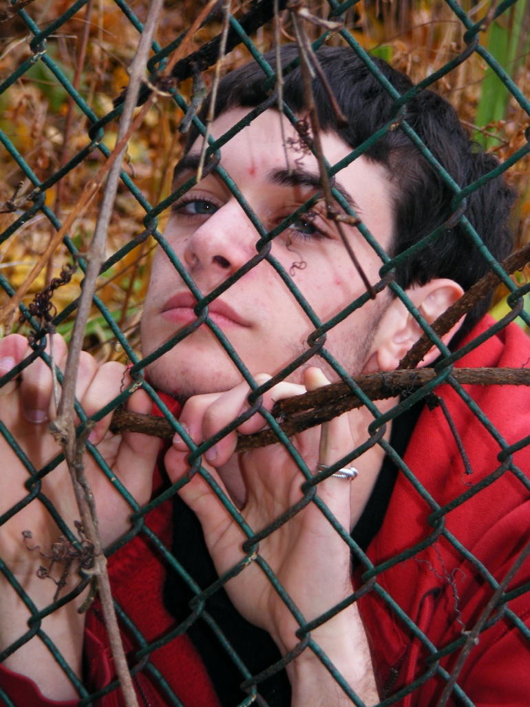
“The John”
On average, they first bought sex at 21 years old. (1)
Age of first purchased sex experience ranges from ages 11 to 49. (1)
Peer pressure was a primary reason they first bought sex. (1)
Significantly more sex buyers (94%) than non-sex buyers (54%) had visited a strip club. (2)
Frequent “Johns” are more likely to be married/older. (2)
Melissa Farley, Emily Schuckman, Jacqueline M. Golding, Kristen Houser, Laura Jarrett, Peter Qualliotine, Michele Decker, Comparing Sex Buyers with Men Who Don’t Buy Sex: “You can have a good time with the servitude” vs. “You’re supporting a system of degradation” (2011) at p. 14 Prostitution Research & Education, available at http://www.prostitutionresearch.com/pdfs/Farleyetal2011ComparingSexBuyers.pdf.
Melissa Farley, Emily Schuckman, Jacqueline M. Golding, Kristen Houser, Laura Jarrett, Peter Qualliotine, Michele Decker, Comparing Sex Buyers with Men Who Don’t Buy Sex: “You can have a good time with the servitude” vs. “You’re supporting a system of degradation” (2011) at p. 16 Prostitution Research & Educ., available at http://www.prostitutionresearch.com/pdfs/Farleyetal2011ComparingSexBuyers.pdf.
Buying Sex: A Survey of Men in Chicago (2004) at 1, Chicago Coal. for the Homeless, available at http://www.enddemandillinois.org/research.

Slide 31
MYTH: “I paid money, so she has to do what I want.”
FACT:
Research on prostitution has shown that
62-100% of the acts of violence against women engaged in street-level prostitution were perpetrated by the “Johns”. (1)
30-100% of all acts of violence, including almost all acts of sexual violence against women in exotic dancing were perpetrated by the “Johns”. (1)
Jody Raphael & Deborah L. Shapiro, Sisters Speak Out: The Lives and Needs of Prostituted Women in Chicago, Center for Impact Research (2002) at p.19, available at http://www.impactresearch.org/documents/sistersspeakout.pdf.

Slide 32
In another study of 103 sex-buyers,
54% believed prostitution decreases rape, and
25% considered the idea of raping a prostitute to be ridiculous, believing that prostitutes are “unrapeable.” (2)
Rape
Myths
In a study comparing buyers and non-buyers of sex,
32% of sex buyers and 20% of non-sex buyers stated their belief that prostitution reduces
the likelihood of
rape. (1)
The truth is…
68% of women in a prostitution study had been raped while working as prostitutes. (1)
Melissa Farley, Emily Schuckman, Jacqueline M. Golding, Kristen Houser, Laura Jarrett, Peter Qualliotine, Michele Decker, Comparing Sex Buyers with Men Who Don’t Buy Sex: “You can have a good time with the servitude” vs. “You’re supporting a system of degradation” (2011) at 20 Prostitution Research & Educ., available at http://www.prostitutionresearch.com/pdfs/Farleyetal2011ComparingSexBuyers.pdf.
Melissa Farley, Julie Bindel, Jacqueline M. Golding, Men Who Buy Sex: Who They Buy and What They Know (December, 2009), available at http://www.eaves4women.co.uk/Documents/Recent_Reports/Men%20Who%20Buy%20Sex.pdf.

Slide 33
Rape myths include the beliefs that:
Women say no to sex but
really mean yes. (1)
Certain clothes worn by
women signal their desire to
be sexually assaulted. (1)
Culturally accepted myths about rape hide the truth that rape still occurs in prostitution, and that commercial sex does not ensure safety to non-prostituting women.
Reasons 110 sex-buyers
gave for rape included:
32% stated that men get “sexually carried away.” (2)
34% said that a
man’s “sex drive
gets out of control.” (2)
37% of 103 sex-buyers stated they had “tricked non-prostituting women into having sex.” (3)
16% of those buyers claimed they would rape a woman if they knew they would not get caught. (3)
Melissa Farley, Emily Schuckman, Jacqueline M. Golding, Kristen Houser, Laura Jarrett, Peter Qualliotine, Michele Decker, Comparing Sex Buyers with Men Who Don’t Buy Sex: “You can have a good time with the servitude” vs. “You’re supporting a system of degradation” (2011) at 20 Prostitution Research & Educ., available at http://www.prostitutionresearch.com/pdfs/Farleyetal2011ComparingSexBuyers.pdf.
Melissa Farley, Jan Macleod, Lynn Anderson, Jacquline M. Golding. Psychological Trauma: Theory, Research, Practice, and Policy. (March, 2011). Available at http://www.prostitutionresearch.com/pdfs/Farley,Macleod%20et%20al%202011%20Men%20Who%20Buy%20Sex%20In%20Scotland.pdf]
Melissa Farley, Julie Bindel, Jacqueline M. Golding, Men Who Buy Sex: Who They Buy and What They Know (December, 2009), available at http://www.eaves4women.co.uk/Documents/Recent_Reports/Men%20Who%20Buy%20Sex.pdf.

Slide 34
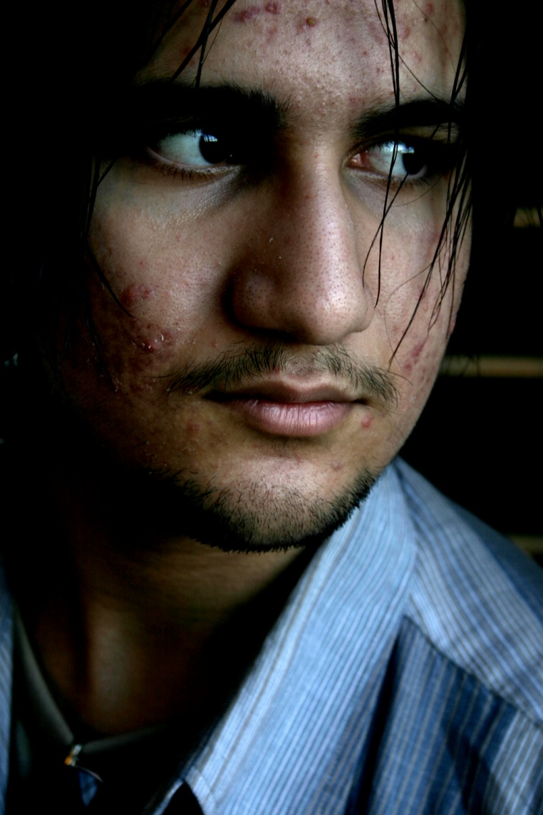
“The John”
The majority of “Johns” DO NOT recognize the negative aspects of buying sex.
Of the 101 sex buyers considered in a research study on prostitution:
67% indicated no or slight negative effects. (1)
19% indicated very negative effects. (1)
14% indicated extremely negative effects. (1)
Of the 100 non-sex buyers:
30% indicated no or slight negative effects. (1)
47% indicated very negative effects. (1)
23% indicated extremely negative effects.” (1)
Melissa Farley, Emily Schuckman, Jacqueline M. Golding, Kristen Houser, Laura Jarrett, Peter Qualliotine, Michele Decker, Comparing Sex Buyers with Men Who Don’t Buy Sex: “You can have a good time with the servitude” vs. “You’re supporting a system of degradation” (2011) at 20 Prostitution Research & Educ., available at http://www.prostitutionresearch.com/pdfs/Farleyetal2011ComparingSexBuyers.pdf.

Slide 35
Medical and Legal

Slide 36
Both victims of sex trafficking and “Johns” are at risk of contracting STDs.
Human Papillomavirus Transmission not prevented by condoms (2)
There are an estimated 19 million sexually transmitted infections in the U.S. (1)
2012 Sexually Transmitted Diseases Surveillance, CDC, available at http://www.cdc.gov/std/stats10/trends.htm.
Genital HPV Infection – Fact Sheet (2011), CDC, available at http://www.cdc.gov/STD/HPV/STDFact-HPV.htm Noting “HPV can infect areas that are not covered by a condom - so condoms may not fully protect against HPV”).

Slide 37
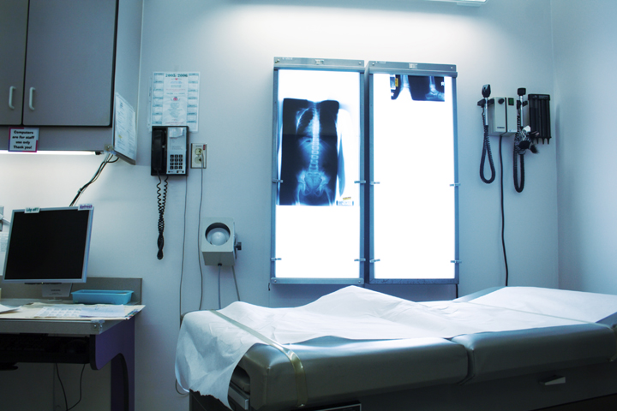
Gonorrhea
Over 700,000
new infections
per year in US. Females usually
asymptomatic carriers (1)
Chlamydia
Most common STD, highest incidence in 15-19 year olds (2)
All these STDs have grim consequences.
Gonorrhea – CDC Fact Sheet (2011), CDC, available at http://www.cdc.gov/std/gonorrhea/stdfact-gonorrhea.htm.
Sexually Transmitted Disease Surveillance (2010) at 8, CDC, available at http://www.cdc.gov/std/stats/.

Slide 38
STD Consequences
May give your wife
a lethal as well as embarrassing
disease
The law also
requires you
to disclose all
your sexual contacts, and the
State Board of Health will contact them.
Liver cancer
Cervical cancer
Antibiotic resistance is rising
Infertility
Some STDs are incurable.
Few female commercial sex workers visit STD clinics because of discrimination, fear of legal consequences, loss of confidentiality.

Slide 39
State Law
Federal
Law
IC 35-42-3.5: Human and Sexual Trafficking (1)
Victims of Trafficking and Violence Prevention Act-2000 (2)
William Wilberforce Trafficking Victims Protection Reauthorization Act of 2008 (3)
Human and Sexual Trafficking, Ind. Code § 35-42-3.5, available at http://www.in.gov/legislative/ic/code/title35/ar42/ch3.5.pdf.
Victims of Trafficking and Violence Protection Act of 2000, Pub. L. No. 106-386 (2000), available at http://www.state.gov/documents/organization/10492.pdf.
William Wilberforce Trafficking Victims Protection Reauthorization Act of 2008, Public Law No: 110-457 (2008), available at http://www.govtrack.us/congress/bill.xpd?bill=h110-7311.

Slide 40
IC 35-45-4-3, Patronizing a Prostitute
Is a Class A misdemeanor. (1)
However, the offense is a Class D felony if the person has two prior convictions under this section. (1)
Patronizing a Prostitute, IC 35-45-4-3, available at www.in.gov/legislative/ic/code/title35/ar45/ch4.html.

Slide 41
Trafficking Victims Protection Act of 2000
A Comprehensive Law:
Prevention
Public Awareness, Outreach and Education
Protection
T-Visa, Certification, Benefits and Services to Victims
Prosecution
Created Federal Crime of Trafficking, New Law Enforcement Tools and Efforts

Slide 42
Federal Crimes and Penalties
Forced Labor | Up to 20 years
Trafficking into Servitude | Up to 20 years
Sex Trafficking | Up to life
Involuntary Servitude | Up to 20 years
Peonage (Debt Bondage) | Up to 20 years
Document Servitude | Up to 5 years
Conspiracy Against Rights | Up to life if kidnapping, sexual abuse or death

Slide 43
What is Force, Fraud, & Coercion?
Force
Kidnapping
Torture
Battering
Threats with Weapons
Sexual Abuse
Confinement
Forced use of Drugs
Forced Abortions
Denial of Medical Care
Fraud
Promises of Valid Immigration
Documents
Victim told to use false travel
papers
Contract signed for
Legitimate Work
Promised Job differs from
Actuality
Promises of Money or Salary
Misrepresentation of
Work Conditions
Wooing into Romantic
Relationship
Coercion
Debt Bondage
Threats of Harm to Victim or Family
Control of Children
Controlled Communication
Photographing in Illegal Situations
Holding ID/Travel Documents
Verbal or Psychological Abuse
Control of Victims Money
Punishments for Misbehavior

Slide 44
Distinguishing Trafficking from other Crimes
Human trafficking is sometimes mistakenly identified as a different major crime. Some examples are:

Slide 45
Human Trafficking vs. Smuggling
Smuggling is the illegal transportation of a person across international borders.
Smuggling is typically voluntary, and the person is free to leave afterwards.
A trafficked person may be transported into a country, but the person is then exploited for financial gain through labor or services.
Human Trafficking vs. Sexual Assault
Human Trafficking requires that the person has been forced to provide sexual services for profit.
If other factors are present, sexual assault can be a type of control in a trafficking scenario.
Human Trafficking vs. Prostitution
Human Trafficking requires that the victim has been compelled to prostitute through force, fraud or coercion. The profit is often taken by the trafficker.

Slide 46
If you believe someone is a victim of Human Trafficking
If a crime is in progress or there’s immediate danger, call 911.
Indianapolis Trafficked Persons Assistance Program 24-hour hotline: 1-800-928-6403
National Human Trafficking Resource Center Hotline Number 1-888-3737-888

Slide 47
The Julian Center and Exodus Refugee Immigration Inc. partner to administer a Trafficked Persons Assistance Program. This program offers:
Case management
Emergency housing
Legal services
Safety planning
Counseling
Immigration aid
Medical assistance
Food
Clothing
Job training

Slide 48
Human trafficking is in our community and growing.
Victims of trafficking may be foreign-born or U.S. citizens.
The AVERAGE age of entry into commercial sex is 12-14. (1)
We have failed to protect these children.
They could be my daughter, my sister, my brother.
Child Prostitution, U.S. Dept. of Justice, CEOS, http://www.justice.gov/criminal/ceos/prostitution.html (last visited Jan. 13, 2012); see also U.S. Children are Victims of Sex Trafficking (April 2008), humantrafficking.org, http://www.humantrafficking.org/updates/801.

Slide 49
Talk about it. Talk to your friends about the fact that there is a direct connection between prostitution, lap dancing and strip clubs and missing and exploited children. In interviews, Johns admit that they would be deterred from buying sex if they were held criminally and socially accountable.
Speak out. Don’t tolerate or use the lingo. When prostitution is portrayed as a choice or “funny” in movies, talk about the reality. Don’t glorify the “pimp” culture. Share these facts with others.

Slide 50
Commit to not participating in the commercial sex industry. Take the Pledge:
To not purchase or participate in prostitution or the commercial sex industry
To hold friends accountable and demand their respect for women and children
To take action on behalf of those vulnerable to sex trafficking
Take part in creating cultural change.
Encourage education for youth on topics such as healthy relationships, self-identity, life skills…
Support local organizations that serve victims of human trafficking
Only we can change the culture of toleration of human trafficking.

Slide 51
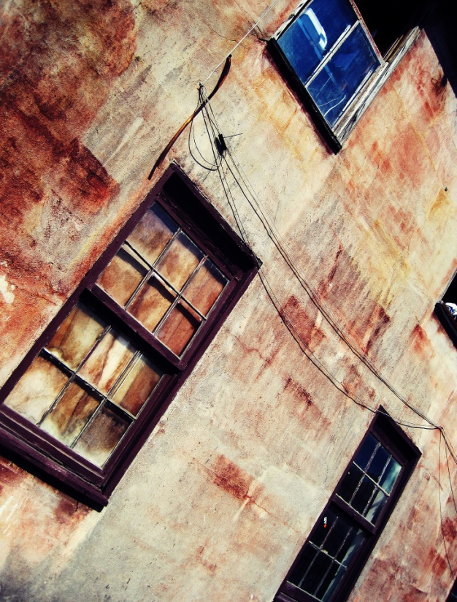
Neighborhood Christian Legal Clinic
3333 North Meridian St.
Indianapolis, IN 46208
(317) 429-4131 nclegalclinic.org
The Julian Center
2011 North Meridian St.
Indianapolis, IN 46202
(317) 941-2200
www.juliancenter.org
Exodus Refugee Immigration Inc.
1125 Brookside Ave, Suite C9
Indianapolis, IN 46202
(317) 921-0836
www.exodusrefugee.org

Slide 52
We would like to thank
IPATH, Indiana Attorney General, Neighborhood Christian Legal Clinic, Exodus Refugee Immigration Inc, Freedom Network USA, Shared Hope, Polaris Project, LexisNexis and the Human Rights Center
for providing information for this presentation.

