Slide 1
General Awareness Training Presentation 2020

Slide 2
Warning!
The Department of Defense (DoD) Trafficking in Persons General Awareness Training contains language and images depicting physical violence and sexual violence to accurately portray the nature of trafficking in persons. DoD has determined that this level of candor is necessary in order to properly convey the subject matter.

Slide 3
Introduction
In this course, you will learn:
(1) What constitutes Trafficking in Persons (TIP), and the term “severe forms
of trafficking in persons” as defined in Section 7102 of Title 22, U.S.C.
(2) Why TIP occurs.
(3) Who is involved in TIP.
(4) How TIP occurs.
(5) Methods in combating TIP.
(6) TIP laws and policies.
(7) The prevalence of DoD-related human trafficking.
(8) How human trafficking can affect mission readiness.
(9) The human trafficking concerns in the DoD.
(10) The basic characteristics of human trafficking crimes.
(11) Your role in combating human trafficking.
(12) Reporting procedures for alleged TIP violations.
Notes:
Welcome to the Department of Defense Trafficking in Persons General Awareness Training for Department of Defense employees.
The required subject matter for the CTIP general awareness training will include the terminal learning objectives (TLOs) drawn from the Department of Defense Instruction 2200.01, “Combating Trafficking in Persons (CTIP)” published in June 2019.
NOTE: The term “trafficking in persons” is the legal term;
“human trafficking” is a colloquial term and often used to describe TIP.

Slide 4
What is Trafficking in Persons (TIP)?
The Trafficking Victims Protection ACT (TVPA) of 2000
defined “severe forms of trafficking” as:
The recruitment, harboring, transportation, provision, or obtaining of a person for labor or services, using force, fraud, or coercion for the purpose of subjection to involuntary servitude, peonage,
debt bondage, or slavery
Sex trafficking in which a commercial sex act is induced by force, fraud, or coercion, or in which
a person induced to perform such act has not attained 18 years of age;
OR
Notes:
The US Trafficking Victims Protection Act (TVPA) of 2000 defined severe forms of trafficking in 22 U.S.C 7102 (11) as:
sex trafficking in which a commercial sex act is induced by force, fraud or coercion, or in which a person induced to perform such act has not attained 18 years of age; or
the recruitment, harboring, transportation, provision, or obtaining of a person for labor or services, using force, fraud, or coercion for the purpose of subjection to involuntary servitude, peonage, debt bondage, or slavery.
The DoD prohibits Trafficking in Persons (TIP) and investigates TIP incidents because it is:
A crime
An abuse of human rights
Not compatible with military core values
An action that jeopardizes DoD’s credibility and ability to achieve its mission

Slide 5
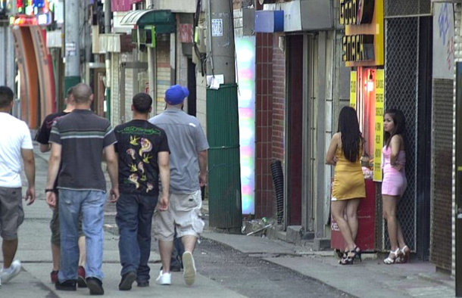
Sex Trafficking
Sex trafficking is the
recruitment,
harboring,
transportation,
provision,
obtaining,
patronizing, or
soliciting
of a person for the purpose of
a commercial sex act.
Victims of sex trafficking can be found anywhere, but are often found in:
Bars and Brothels
Dance clubs and strip clubs
Massage parlors and spas
Escort services
Private parties
Pornography industry
Notes:
As defined by the Trafficking Victims Protection Act (TVPA) of 2000 {22 U.S.C. Section 7102 (12)}, sex trafficking involves the recruitment, harboring, transportation, provision, patronizing , soliciting, or obtaining of a person for the purpose of a commercial sex act.
Congress amended Section 1591 of Title 18, United States Code, to add the words ‘‘solicits or patronizes’’ to the sex trafficking statute making absolutely clear for judges, juries, prosecutors, and law enforcement officials that people who purchase sex involving a person subject to severe forms of trafficking in persons may be arrested, prosecuted, and convicted as sex trafficking offenders.

Slide 6
Sex Trafficking Case in DoD
In 2014, the Naval Criminal Investigative Service (NCIS) initiated an investigation after receiving allegations that a Navy Petty Officer was trafficking a minor for the purpose of prostitution in GA, NC and VA. He connected with the minor online and drove her to apartments where he sold her to other men for sex.
The petty officer pleaded guilty to transporting the minor interstate to engage in racketeering and was sentenced to five years’ confinement, three years of supervised probation, and ordered to register as a sex offender.
Notes:
Case Details: Subject pleaded guilty to one count of violation of 18 U.S.C. 1952(a)(3) (Interstate and Foreign travel or transportation in aid of racketeering enterprises) and was administratively separated from the USN in 2014.
This is one of hundreds of cases of sex trafficking-related crimes among military personnel, DoD civilians, and contractors. Many of these cases were pursued by local and state law enforcement and some military members were charged under Article 134 of the Uniform Code of Military Justice, which prohibits prostitution, pandering, procuring, and purchase of sex.
.

Slide 7
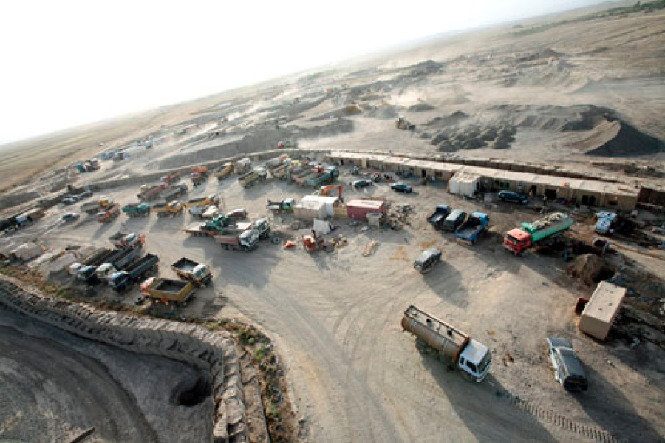
Labor Trafficking
Labor trafficking is the
recruitment,
harboring,
transportation,
provision, or
obtaining
of a person using force, fraud, or coercion to compel labor or services.
It includes:
involuntary servitude,
peonage,
debt bondage,
and/or slavery.
In the DoD, labor trafficking occurs most often in contracts that cover labor intensive industries such as:
Food services
Janitorial and disposal services
Truck and driver services
Security guards
Construction work
Notes:
As defined by the Trafficking Victims Protection Act (TVPA) of 2000 {22 U.S.C. Section 7102(11)}, severe forms of trafficking involve the recruitment, harboring, transportation, provision, or obtaining of a person for labor or services, through the use of force, fraud, or coercion for the purpose of forced labor (involuntary servitude, peonage, debt bondage, or slavery).
Photo: Construction in Afghanistan, Stars & Stripes.

Slide 8
Labor Trafficking Case in DoD
In 2012, the Defense Contract Management Agency (DCMA) conducted an audit in response to a report from a Service member about contractor employees being beaten by their employer. When auditors investigated, they discovered worker safety issues including substandard housing conditions such as unsanitary water, cockroach infestation, no working fire extinguishers, and a large hole in the roof. In addition, four individuals were found locked in rooms. DCMA documented a total of eight non-conformances at the site.
After a second audit, DCMA issued a Corrective Action Request (CAR) to the prime contractor and submitted a report for a possible criminal investigation. The prime contractor responded quickly to the issues with the subcontractor to correct the non-conformances. DCMA followed up to ensure that the subcontractor had corrected the issues and closed the case the next year.
Notes:
Some cases of trafficking are criminal cases, such as a person who traffics a minor for sex. This case is an example of a non-criminal (administrative) case, where the violations are contract compliance issues. In these cases, non-judicial actions are taken against the contractor. Actions can range from Corrective Action Requests to the suspension and debarment of the contractor if they do not comply with the requests to fix the problems.

Slide 9
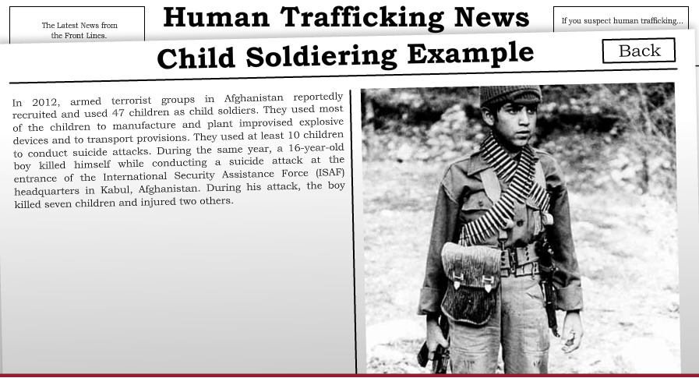
Child Soldiering
The term child soldier means:
Any person under 18 years of age who takes direct part in hostilities as a member of governmental armed forces.
Any person under 18 years of age who has been compulsorily recruited into governmental armed forces.
Any person under 15 years of age who has been voluntarily recruited into governmental armed forces.
Any person under 18 years of age who has been recruited or used in hostilities by armed forces distinct from the armed forces of a state.
Child soldiers are forced to fight but also used as cooks, porters, spies, couriers, medics, guards,
and sex slaves.
Notes:
In some circumstances in the United States Department of Defense, parental consent allows for an individual to be voluntarily recruited into the military when under 18 years of age.
Child soldiers can be found in different locations around the world. Each year, the U.S. Department of State publishes the Trafficking in Persons (TIP) Report and one of the trafficking violations they report on is the use of child soldiers in countries around the world. The list of countries changes annually. To see the most current list, and look at past TIP Reports, use this link:
https://www.state.gov/reports/2019-trafficking-in-persons-report/.

Slide 10
Child Soldier Case Affecting DoD
In 2012, armed terrorist groups in Afghanistan reportedly recruited and used 47 children as child soldiers. They used most of the children to manufacture and plant improvised explosive devices and to transport provisions. At least 10 children were used to conduct suicide attacks.
That year, a 16-year-old boy killed himself while conducting a suicide attack at the entrance to the International Security Assistance Force (ISAF) headquarters in Kabul. During the attack, seven children were killed and two others were injured.

Slide 11
Question 1
Which of the following describe a victim of human trafficking?
Select all that apply:
A person who was compelled to perform labor or commercial sex using force, fraud, or coercion
A 16-year old child compulsorily recruited to fight in governmental armed forces.
A minor engaged in commercial sex
A person who consented to work, but fraud and coercion were used to get that consent
Notes:
Which of the following describe a victim of human trafficking?
Select all that apply:
A person who was compelled to perform labor or commercial sex through force, fraud, or coercion
A 16 year old child compulsorily recruited to fight in governmental armed forces.
A minor engaged in commercial sex
A person who consented to work, but fraud and coercion were used to get that consent
Feedback: Victims of human trafficking are compelled to perform labor or commercial sex using force, fraud, or coercion.

Slide 12
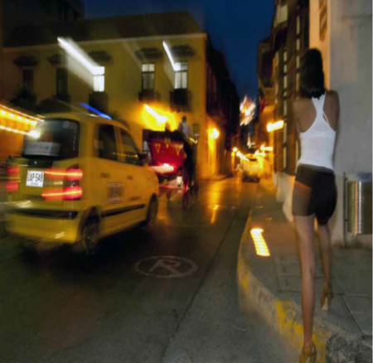
Why Trafficking in Persons Occurs
There are two main reasons trafficking occurs:
Traffickers fill a demand for sex or labor, by selling vulnerable people, such as women and children
Terrorists, organized crime, and extremist groups use human trafficking to fund their operations and further their criminal enterprises
Notes:
Human trafficking is big business and demand is the driving force behind human trafficking. To meet demand for sex or labor, vulnerable populations are exploited and enslaved.
Terrorists, organized crime, and extremist groups use human trafficking to fund their operations
Children and women are typically vulnerable and relatively easy targets to force or coerce into sex trafficking
Workers from other countries, recruited by subcontractors, have been subjected to steep recruitment fees, unsafe working and living conditions, or violence and abuse on the job

Slide 13
How Trafficking in Persons Occurs
Action
Means**
For Purpose of
  Recruiting
  Harboring
  Transporting
  Providing
  Obtaining
  Patronizing or Soliciting *
  a person
  Through:
  Force
  Fraud
  Coercion
  ** Minors induced into commercial sex are TIP victims – regardless of force, fraud, or coercion
  Forced Labor
  Involuntary Servitude
  Debt Bondage
  Slavery
  Commercial Sex
*for sex trafficking only
Notes:
This is the basic AMP Model of Trafficking. AMP = Action, Means, Purpose, is a visual depiction of the federal definition of severe forms of trafficking in the Trafficking Victims Protection Act of 2000 (TVPA), Public Law 106-386.
.
Trafficking is the recruiting transporting, harboring, providing, or obtaining a person (add patronizing or purchase of sex for sex trafficking) using force, fraud, or coercion for purposes of any kind of forced labor (involuntary servitude, debt bondage, slavery) or for commercial sex. Any minor induced into commercial sex is a de facto victim of sex trafficking.
Graph is based on AMP models from U.S. Department of Justice and U.S. Department of Health and Human Services; tailored for DoD

Slide 14
Who are the Victims?
Who are the Traffickers?
Victims can be:
Traffickers can be:
Any gender, age, race, nationality, social status, economic or immigration status
Female or male
Adult or child
Foreign national or U.S. citizen
Homeless youth
Undocumented migrants
People displaced by civil conflicts and natural disasters
Service members, DoD civilians, and DoD contractor employees, DoD family members
Members of organized crime groups
Terrorist organizations
Gangs and warlords
Foreign national or U.S. citizen
Male or female
Pimps
Business Owners
Family members
Service members, DoD civilians, and DoD contractors, DoD family members
Notes:
Who can be a human trafficking victim? We may have a stereotypical view of who can be a victim of trafficking. The reality is that a victim of trafficking is a vulnerable person that has been exploited. Victims can be any age, race, nationality and even social status. They can be female or male, child or adult, foreign national or United States citizen. They can even be veterans, active service members, DoD civilians and DoD contractors.
Who can be a trafficker? A trafficker can be anyone who seeks to exploit and manipulate vulnerable individuals. They can be members of organized crime, terrorist organizations, and warlords. They can be either male or female, foreign national or United States citizen. They sometimes have a business that is a “front” for their trafficking. They can even be veterans, active service members, DoD civilians and DoD contractors.

Slide 15
TIP Prevalence
Department of Defense Scope
In FY 2018 alone, there were 141 reports of alleged sex or labor trafficking or trafficking-related cases in the DoD
Since FY 2014, DoD has taken disciplinary action, including prosecutions and courts martial, on over 350 trafficking or trafficking-related cases of DoD members involved as traffickers and buyers
Notes:
Source: DoD statistics from CTIP PMO 2018

Slide 16
Question 2
Victims of trafficking can be:
Select all that apply:
Any gender, age, race, nationality, social status, economic or immigration status
Female or male
Adult or child
Foreign national or U.S. citizen
Notes:
Victims of trafficking can be:
Select all that apply:
Any gender, age, race, nationality, social status, economic or immigration status
Female or male
Adult or child
Foreign national or U.S. citizen
Feedback: We may have a stereotypical view of who can be a victim of trafficking. The reality is that a victim of trafficking is a vulnerable person that has been exploited. Victims can be any age, race, nationality and even social status. They can be female or male, child or adult, foreign national or United States citizen.

Slide 17
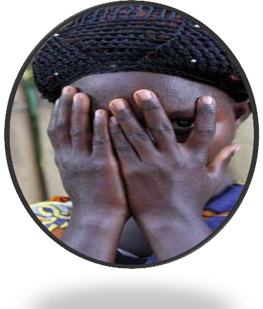
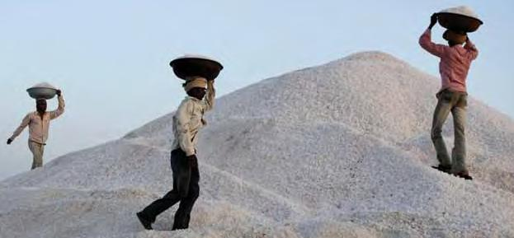
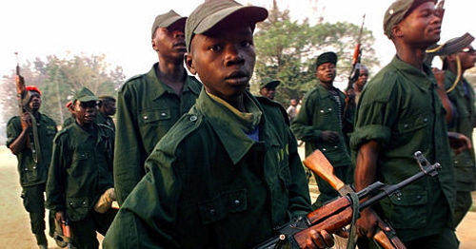
Effects on Mission Readiness
Terrorists, organized crime, and extremist groups use trafficking to fund their crimes
Children are being trafficked to serve as child soldiers
Sex traffickers near military installations target service members
Contracted employees subjected to unfair treatment
Notes:
Terrorists, organized crime, and extremist groups use trafficking to fund their crimes
Children are being trafficked into rogue and extremist militias to serve as child soldiers
Subcontract employees form government contracts on military installation have been subjected to steep recruiting fees, unsafe working and living conditions, or violence and abuse on the job
Sex traffickers who operate near U.S. military installations target service members
CHILD SOLDIER PHOTO: Human Trafficking Center
URL: http://humantraffickingcenter.org/effective-practices-to-disarm-demobilize-and-reintegrate-former-child-soldiers/

Slide 18
What is a “Gross Violation of Human Rights (GVHR)?”
GVHRs are human rights abuses carried out by foreign security forces under “color of law,” meaning while on duty, and include:
Torture
Cruel, inhuman, or degrading treatment or punishment
Prolonged detention without charges and trial,
Abduction and clandestine detention, and other flagrant denial of the right to life, liberty, or the security of person.”
Extrajudicial killing
Sexual slavery, enforced prostitution, and rape
Notes:
Any kind of sexual slavery is considered a Gross Violation of Human Rights. Definition for GVHR found in 22 U.S.C. § 2304.
Color of law is defined as an act carried out under color of law when a person acts, purports or pretends to act in the performance of official duties under any law, ordinance or regulation. Such acts may be beyond the bounds of the official’s lawful authority. Off-duty conduct may be covered under color of law, if the perpetrator asserts his or her official status in some manner. The term applies to any military personnel regardless of nation.
Source: https://www.law.cornell.edu/uscode/text/22/2304

Slide 19
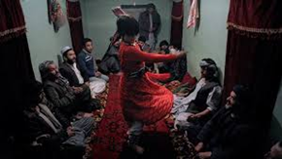
Reporting GVHR
  Report all suspected abuses through Chain of Command or Inspector General
  Follow command/agency reporting procedures
Notes:
The photo is a picture of “bacha bazi” – boys sold into sexual slavery in Afghanistan. Bacha bazi and traditional practices like this are considered Gross Violations of Human Rights (GVHR) and trafficking in persons, due to the fact that children are being sexually abused and exploited by members of a security force while they are on duty. DoD has made special efforts to put new policies and procedures into place to address these problems when they occur under color of law.
PHOTO: © Martin von Krogh

Slide 20
Trafficking Victims Protection Act (TVPA) of 2000
Establishes a whole of government approach to combating trafficking in persons.
Sets a 3P framework:
  Prevention: Encourages education, awareness and training to understand trafficking, identify victims, and respond appropriately
  Prosecution: Encourages a vigorous law enforcement response to traffickers
  Protection and assistance: Provides holistic services for survivors
TVPA was reauthorized in 2003, 2005, 2008, 2013, and 2018.
Notes:
The Trafficking Victims Protection Act (TVPA) was passed in 2000 (Public Law 106-386). It created a 3 P framework - Prevention of trafficking, Prosecution of traffickers, and Protection and Assistance for victims - to establish a comprehensive approach to trafficking in persons.
It has been reauthorized five times (2003, 2005, 2008, 2013, and 2018).

Slide 21
U.S. Government’s Zero Tolerance Policy
The United States adopted a zero-tolerance policy with the signing of the National Security Presidential Directive 22 (NSPD-22) in 2002.
DoD Instruction 2200.01, “Combating Trafficking in Persons (CTIP),” established DoD TIP policies, responsibilities, and reporting requirement for promoting the U.S. Government’s zero tolerance policy within the DoD. (first published in 2007, updated in 2010, 2015, and 2019)
Notes:
In 2002, the United States adopted a zero-tolerance policy on trafficking in persons with the National Security Presidential Directive 22.
In addition to this document, the DoD Instruction 2200.01 establishes DoD human trafficking policies, responsibilities and reporting requirements in order to promote the U.S. government’s a zero-tolerance policy for TIP. It is DoD policy to deter activities of DoD Service members, civilian employees, indirect hires, DoD contractors, foreign national employees of DoD, and all dependents that could facilitate or support TIP, domestically or overseas. This includes activities such as: prostitution, pimping, pandering, patronizing a prostitute, forced labor and involuntary servitude, document tampering and sex trafficking by force, fraud, or coercion or of children.

Slide 22
Uniform Code of Military Justice (UCMJ), Article 134
Criminal code that applies to Service members, and in time of declared war or a contingency operation, persons serving with or accompanying U.S. Armed Forces in the field.
Prosecutable offenses under UCMJ related to sex trafficking include:
  Prostitution
  Patronizing a prostitute
  Pandering by compelling
  Inducing, enticing, or procuring an act of prostitution
  Pandering by arranging or receiving consideration for arranging for sexual intercourse or sodomy
Notes:
Patronizing a prostitute means the purchase of sex.

Slide 23
Question 3
True/False:
Trafficking in persons is not a problem in the Department of Defense.
True
False
Notes:
True/False:
Trafficking in persons is not a problem in the Department of Defense,.
True
False
Feedback: According to the U.S. Department of Justice, the federal government has investigated and prosecuted over 1,200 human trafficking cases in the U.S. since 2000. DoD has investigated and taken action on over 350 military-related cases of sex trafficking or labor trafficking in the last five years.

Slide 24
National Defense Authorization Act (NDAA), 2013
Title XVII, “Ending Trafficking in Government Contracting”
Allows the government to terminate a contract if the prime or subcontractor commits acts that directly support or advance trafficking in persons. Such acts include:
  Confiscating an employee’s identity or immigration documents
  Failing to provide return transportation or pay for return transportation costs
  Offering employment using fraudulent or misleading pretenses
  Providing housing that fails to meet the host country’s housing and safety standards
  Charging recruitment fees
Imposes monitoring, reporting, and compliance plan requirements on DoD to ensure the U.S. government taxpayer money does not support human trafficking
Notes:
These provisions were enacted to prevent human trafficking in U.S. Government contracts.

Slide 25
Federal Acquisition Regulation (FAR) Subpart 22.17,
“Combating Trafficking in Persons”
During the performance of the contract, contractors, contractor employees, and their agents shall not:
Engage in severe forms of trafficking in persons;
Procure commercial sex acts;
Use forced labor;
Destroy, conceal, confiscate, or otherwise deny access by an employee to the employee’s identity or immigration documents.
Charge Recruitment Fees to employees or prospective employees
Notes:
The FAR implemented the NDAA FY13 provision in FAR 52.222–50, “Combating Trafficking in Persons,”

Slide 26
Justice for Victims of Trafficking Act (JVTA)
The JVTA (2015) enhances victims services and increases training for federal personnel. Provisions include:
  Increases penalties for traffickers and buyers
  Expands the definition of sex trafficking to those patronizing a prostitute and soliciting commercial sex
  Requires DoD to provide DOJ with sex offender registration information for persons required to register who are released from military corrections facilities or convicted under the Uniform Code of Military Justice (UCMJ) and sentences without confinement

Slide 27
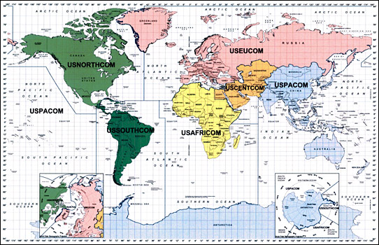
TIP Concerns in DoD’s Areas of Responsibility
Notes:
PHOTO LOCATION: DoD Website Unified Command Page
URL: https://www.defense.gov/About/Military-Departments/Unified-Combatant-Commands/

Slide 28
TIP Concerns in DoD’s Areas of Responsibility
AFRICOM: One type of human trafficking in AFRICOM is child soldiering, which is a problem in Nigeria, Rwanda, Somalia, Sudan, South Sudan, and the Democratic Republic of the Congo. According to UNICEF, there are more than 17,000 child soldiers in South Sudan alone. These children fight for both rebel forces and the government.
EUCOM: Many countries have legalized prostitution and U.S. military members can be prime targets for the sex industry. DoD members in the area need to remember even though prostitution is legal in these countries, it is a punishable offense in the UCMJ, Article 134 ,which prohibits patronizing a prostitute.

Slide 29
TIP Concerns in DoD’s Areas of Responsibility
CENTCOM: Other country nationals working for contractors are vulnerable to deceptive hiring practices, substandard living conditions, unsafe or hazardous working conditions, and other forms of abuse. These workers can become an unstable element (insider threat) on military installations.
PACOM: Approximately two thirds of the estimated victims of human trafficking are in the Indo-Asia Pacific region, or reside within the U.S. Pacific Command Area of Responsibility. U.S. military personnel can be prime targets for the sex industry in this region, with prostitution being a very common occurrence.

Slide 30
TIP Concerns in DoD’s Areas of Responsibility
NORTHCOM: Children, including the children of military members, may be prime targets for traffickers online, at schools, or in neighborhoods. Traffickers have moved to sophisticated business models involving new technologies including smartphones, social media, and specialized apps.
SOUTHCOM: While trafficking crimes occur within the region, Latin America is a primary source region for victims trafficked to the U.S., including by transnational criminal networks such as MS-13.

Slide 31

Take Appropriate Reporting Action
If you suspect a trafficking in persons situation, REPORT IT IMMEDIATELY TO THE APPROPRIATE AUTHORITY
Report to:
  Chain of Command
  Department of Defense Inspector General (IG) Hotline: 1-800-424-9098, or visit http://www.dodig.mil/hotline/)
  National Human Trafficking Resource Center: 1-888-373-7888
Notes:
You should never ignore a situation that appears to involve trafficking in persons. Do not intervene directly. While you might be inclined to investigate or rescue a person it is not safe to act on your own. It is not your responsibility to investigate a situation if you suspect trafficking in persons. You should report the incident to your Chain of Command. You may also call the Department of Defense IG Hotline at 1-800-424-9098 and report the incident. Keep in mind it may be faster to report the incident to your local or command-level Inspector General’s Office.
When in doubt always report situations of human trafficking once you have identified human trafficking indicators.
Use the DoD IG website to report trafficking crimes if you file a Hotline complaint. This helps to ensure anonymity and provides a written record of trafficking reports.

Slide 32
Your Role
Report anything suspicious that you see to your Chain of Command, your local DoD IG office, or use the DoD IG Hotline
Report and Avoid any establishments or persons that you believe may be involved in TIP
Never act ALONE, you may want to help, but trafficking situations are dangerous
  HELP STOP TRAFFICKING.
  REPORT SUSPICIOUS ACTIVITY
Notes:
Report anything suspicious that you see to your chain of command, your local DoD IG office or call the DoD IG Hotline. It is not safe to act on your own and not your responsibility to investigate a situation.
. Reporting suspected TIP violations makes a difference and in some cases, has saved lives. Your everyday decisions impact the culture and climate for mission readiness in the DoD.
Report and Avoid any establishments or persons that you believe may be involved with trafficking in persons. It is your responsibility to do both of these, when you ignore a situation that appears to involve TIP, you compromise not only the safety of the victims involved, but also the safety of those in your unit and the region as a whole.
Never act ALONE, you may want to help but trafficking situations are dangerous.
Reminder: Help stop trafficking. Report suspicious activity.

Slide 33
Question 4
If you suspect a trafficking in persons situation, what should you do?
Select all that apply:
Investigate the situation further
Report the incident through your chain of command and local or command-level Inspector General’s office
Contact the DoD IG Hotline
Confront the suspected traffickers
Notes:
If you suspect a trafficking in persons situation, what should you do?
Select all that apply:
Investigate the situation further
Report the incident through your chain of command and local or command-level Inspector General’s office
Contact the DoD IG Hotline
Confront the suspected traffickers
Feedback: You might be inclined to investigate a situation or rescue a person. It is not safe to act on your own and not your responsibility to investigate a situation. If you suspect trafficking in persons, you should first report the incident through your chain of command and local or command-level Inspector General’s office. You can also contact the Department of Defense IG Hotline.

Slide 34
Conclusion
Congratulations!
You have completed the Department of Defense Trafficking in Persons General Awareness Training. You have learned:
  (1) What constitutes TIP. To utilize the term “severe forms of trafficking in persons,” as defined in Section 7102 of Title 22, U.S.C.
  (2) Why TIP occurs.
  (3) Who is involved in TIP.
  (4) How TIP occurs.
  (5) Methods in combating TIP.
  (6) TIP laws and policies.
  (7) The prevalence of DoD-related human trafficking.
  (8) How human trafficking can affect mission readiness.
  (9) The human trafficking concerns in the DoD.
  (10) The basic characteristics of human trafficking crimes.
  (11) Your role in combating human trafficking.
  (12) Reporting procedures for alleged TIP violations.
Notes:
Thank you for viewing this General Awareness presentation on Combating Trafficking in Persons.

Slide 35
Resources
For more information on:
  Laws and regulations
  Curriculum toolkits
  Learning objectives
  Awareness materials
  Reports and documents
Visit: http://ctip.defense.gov

Slide 36

Department of Defense Combating Trafficking in Persons
This is to certify that
has successfully completed the CTIP training requirement
Linda K. Dixon
Linda K. Dixon, Program Manager,
Combating Trafficking in Persons Program Office
DOD Certified IAW DODI 2200.01

